Slide 1


Department of BES-I
COURSE: Data Structures through Python
COURSE CODE: 24SC1204
Topic:
Name of the topic:
AVL TREES INSERTION
Session – 28

Slide 2



AIM OF THE SESSION
To familiarize students with the insertion and implementation of AVL Trees
INSTRUCTIONAL OBJECTIVES
This Session is designed to:
Demonstrate insertion AVL Trees
List out the operations possible of insertion in AVL Trees.
Describe the each operation
Describe the rotations to be taken while insertion a new node in AVL Trees.
List out the advantages and applications of AVL Trees.
LEARNING OUTCOMES
At the end of this session, you should be able to:
Describe four rotations of AVL Trees during Insertion and their operations.
Summarize definition, types and operations of AVL Trees and its applications.
Discuss about the time complexity of AVL Tree during insertion in 3 cases.

Slide 3
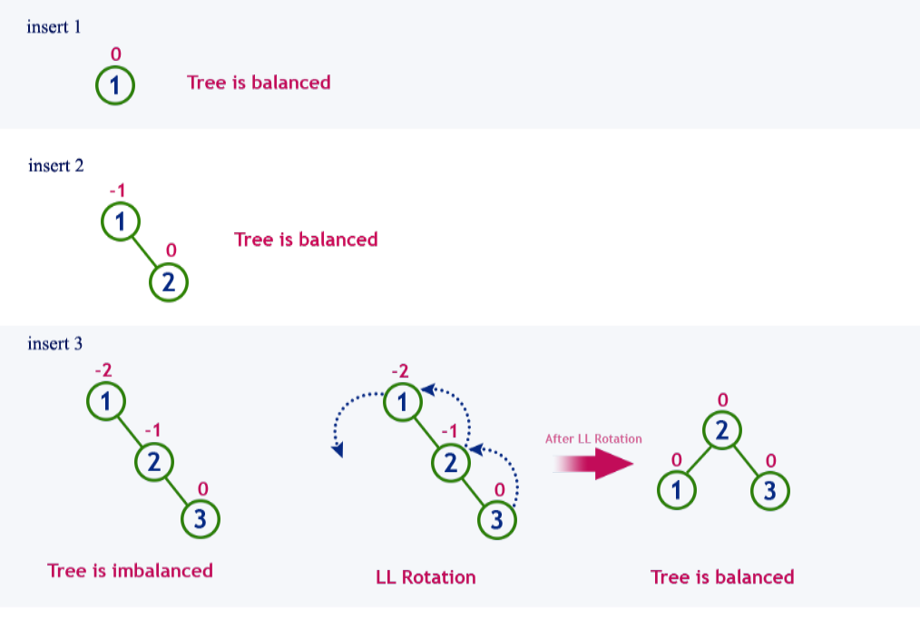
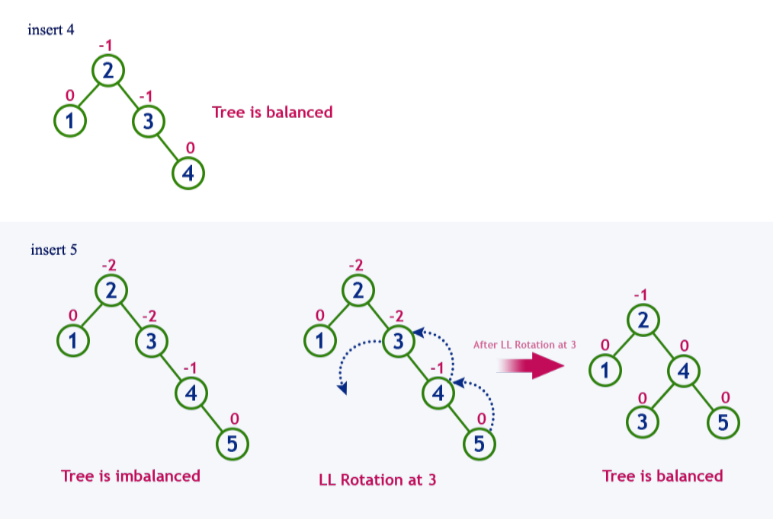
INSERTION
Example :Construct an AVL Tree by inserting numbers from 1 to 8.

Slide 4
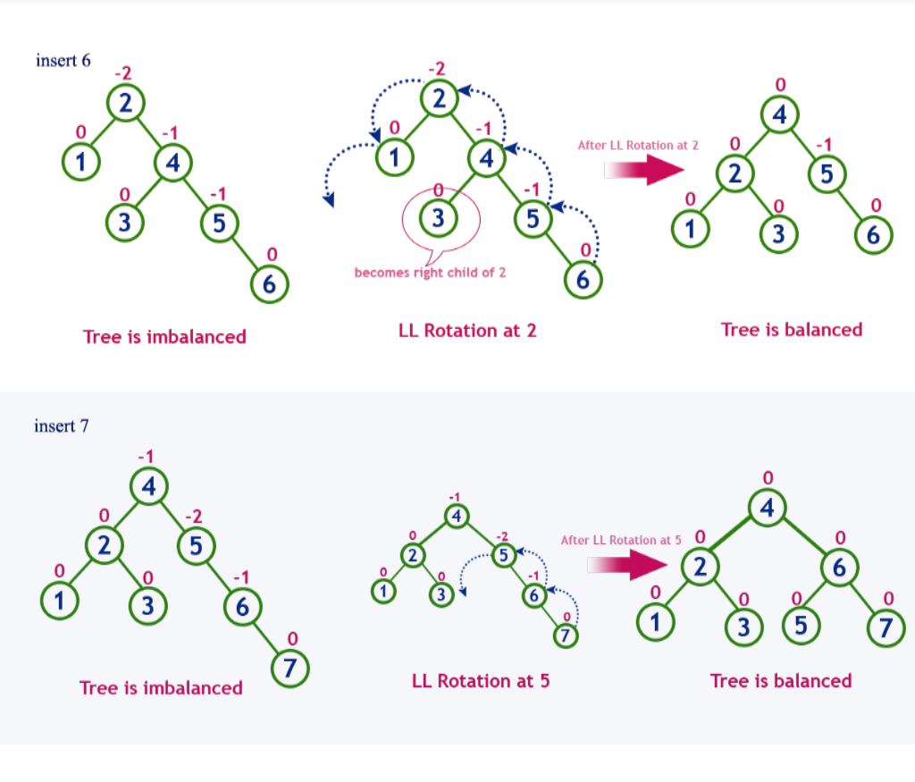
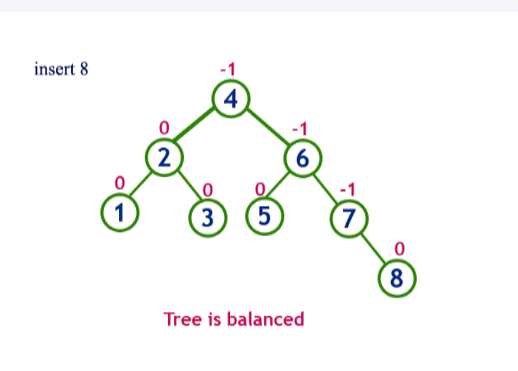
EXAMPLE(Cont..)

Slide 5
Deletion operation:-Deletion in the AVL Trees take place in three different scenarios
DELETION
Scenario 1 (Deletion of a leaf node) − If the node to be deleted is a leaf node, then it is deleted without any replacement as it does not disturb the binary search tree property. However, the balance factor may get disturbed, so rotations are applied to restore it.
Scenario 2 (Deletion of a node with one child) − If the node to be deleted has one child, replace the value in that node with the value in its child node. Then delete the child node. If the balance factor is disturbed, rotations are applied.
Scenario 3 (Deletion of a node with two child nodes) − If the node to be deleted has two child nodes, find the in-order successor of that node and replace its value with the in-order successor value. Then try to delete the in-order successor node. If the balance factor exceeds 1 after deletion, apply balance algorithms.

Slide 6
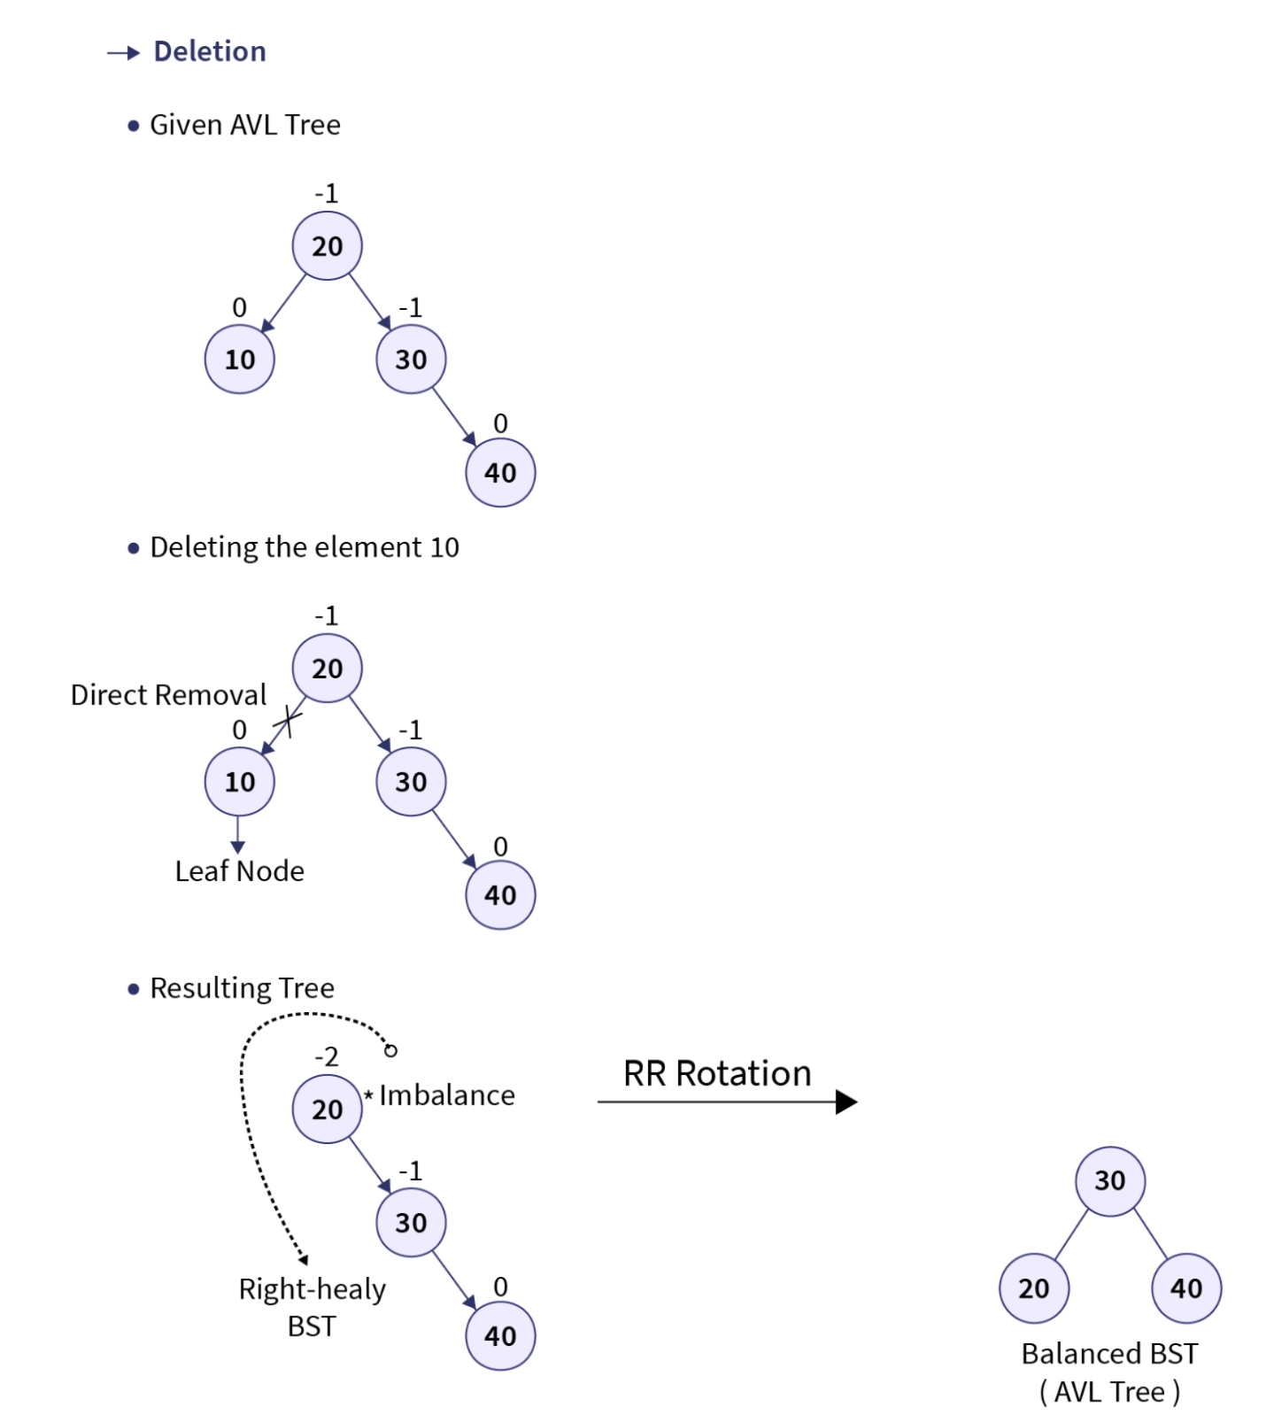
Example for deletion element from the tree:

Slide 7
TIME COMPLEXITY
BEST CASE AVERAGE CASE WORST CASE
Insert O (log n) O (log n) O (log n)
Delete O (log n) O (log n) O (log n)

Slide 8
EXAMPLE
Explain the concept of AVL trees and their self-balancing property. Given the AVL tree with elements 15, 10, 25, 5, 12, 20, and 30 in sequential order, detail the rotations required after each insertion to maintain balance. Illustrate the resulting AVL tree at each step.

Slide 9
IMPORTANT FACTS RELATED TO THE SESSION
Advantages of a AVL Trees
  The AVL tree is always height-balanced, and its height is always O(log N).
  AVL trees have self-balancing properties.
  AVL trees perform better searching operations than Red-Black Trees
  It shows better search time complexity.
Disadvantages of AVL Trees.
  For specific operations, AVL trees show relatively high constant factors.
  Insertion and deletion are slow in AVL trees.
  The AVL Tree applies rotations and the balancing factor, which causes it to have a complicated data structure.
Applications/Uses of AVL Trees.
  Its application is in in-memory and dictionaries to store data.
  Database systems frequently use AVL trees as indexes to allow quick data searching and recovery of data functions.
  AVL trees operate in networking routing algorithms.
  AVL trees encounter applications in interactive storytelling games.

Slide 10
SUMMARY
AVL Tree height is always O(log n) i.e., it has logarithmic time complexity for all the operations.
All AVL Tree operations are similar to BST except insertion and deletion.
When N is large, AVL provides faster and reliable search operation than BST.
The left sub tree has nodes that are lesser than the root node. The right sub tree has nodes that are always greater than the root node.
During deletion operation in AVL Trees balance factor should be verified weather to check the tree is balanced or not.
AVL trees are used where search operation is more frequent compared to insert and delete operations.

Slide 11
SELF-ASSESSMENT QUESTIONS
How many nodes are involved in a single rotation?
a) One
b) Two
c) Three
d) Four
2.Time complexity of AVL Tree
O(n log n)
O(log n)
O(n)
O(n2)

Slide 12
TERMINAL QUESTIONS
1. Show step-by-step AVL tree insertion in the terminal
2. Explain rebalancing after AVL tree deletion in the terminal?
3. Determine the balance factor of each node in a given AVL tree. Identify any potential imbalances and suggest the type of rotations needed to restore balance.
4.Discuss the advantages and disadvantages of using AVL trees?

Slide 13
REFERENCES FOR FURTHER LEARNING OF THE SESSION
Reference Books:
1. Data Structures and Algorithm Analysis in PYTHON, 2010, Mark Allen Weiss, Second Edition, Pearson Education.
2. Data Structures and Algorithms, A.V.Aho, J.E.Hopcroft, and J.D.Ullman, Pearson Education, First Edition Reprint2003.
3. Advanced Guide to Python 3 Programming, John Hunt, 4th Edition, Springer Nature Switzerland AG 2019.
4. Python Basics: A Practice Introduction to Python 3, David Amos, Dan Bader, Joanna Jablonski, Fletcher Heisler, 4th edition, Real Python
Sites and Web links:
1. https://docs.python.org/3/tutorial/datastructures.html
2. https://www.w3schools.com/dsa/dsa_intro.php
3. https://www.geeksforgeeks.org/python-data-structures/

Slide 14
THANK YOU
Team – Data Structures through Python

